Slide 1

PRAELOCATE
J. Le Roux | M. Sass | S. Sorour | B. Spiver | W. Wannenburg

Slide 2

Contents
Team structure
Technology stack
Overview
Progress
Frontend
Backend
Retrospective
Next sprint

Slide 3
Team Structure
Backend
M. Sass
S. Sorour
Frontend
W. Wannenburg
J. Le Roux
B. Spiver

Slide 4
Technology Stack
Backend
Simple Flask API
Google Maps Platform
Geocoder & Distance APIs
Frontend
React app
@google-maps-api/react
@react-geocode

Slide 5
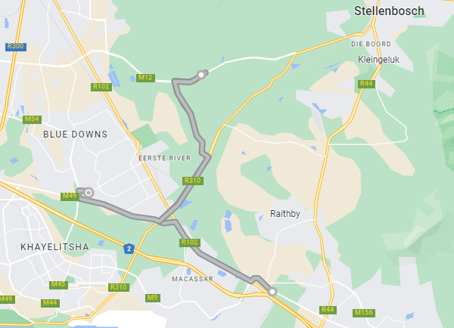
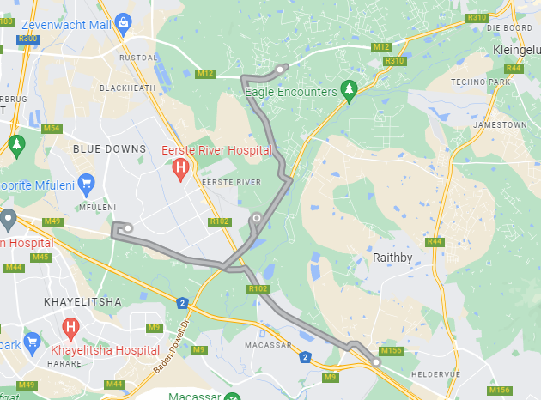
Overview
Midpoint + distance + time
3 Inputs
A
A
D
B
B
C
C

Slide 6
Overview
Google API
locations
locations
Frontend
Backend
time, distance
Input
midpoint
Output

Slide 7
Progress
Conversation with backend
Basic UI setup
Map display
Search box functionality
Full integration

Slide 8
Progress
First POST method
Receiving json
Directions API
Triangulation + GET method
Full integration

Slide 9
Retrospective
This sprint was all about:
getting into the tech
establishing and dividing roles
establishing reliable meeting times
getting a better understanding of the product

Slide 10
Retrospective
What we wanted to get done:
In the demo
None
Did this presentation take too long? Yes
What we didn’t get to:

Slide 11
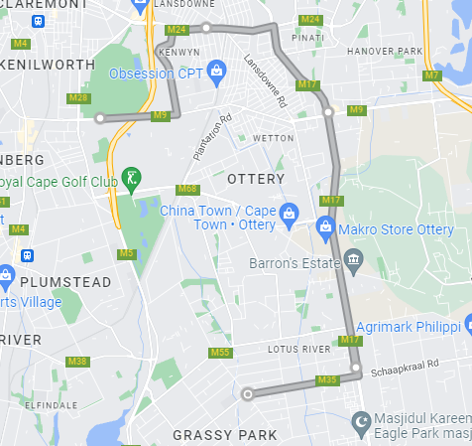
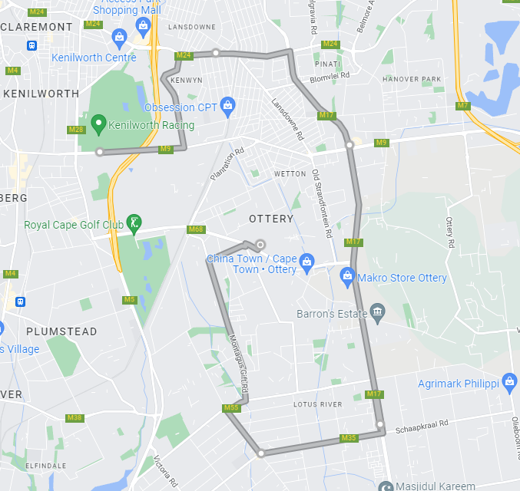
Next Sprint
Different type of locations (biases)
Midpoint improvement and response
Radius output
Improved UX/UI
B
B
A
C
A
C
D
D
E
E

Slide 12
Demo

